Slide 1

Computer Vision Applications
By Quadeer Shaikh

Slide 2

About me
Work Experience
Risk Analyst
Morgan Stanley (Jan 2023 – Present)
Data Science Intern
AkzoNobel Coatings International B.V. Netherlands (Feb 2022 – Dec 2022)
Data Science Intern
EzeRx Health Tech Pvt. Ltd. (Jan 2022 – July 2022)
Associate Engineer
Tata Communications Ltd. (July 2019 – Aug 2020)
Network Automation and Analysis Engineer Intern
Cisco (June 2018 – July 2018)
Education
M.Tech – Artificial Intelligence
NMIMS (2021 - 2023, currently pursuing)
B.E. – Computer Engineering
Mumbai University (2015 - 2019)

Slide 3
Image Operations
Pixel based operations
Contrast Stretching
Thresholding
Inverting/Negative Images
Erosion and Dilation
Bitwise operations, etc.
Regions based operations
Contour Detection
Edge Detection
Corner Detection (not included)
Line Detection, etc.

Slide 4
Features in Images

Slide 5

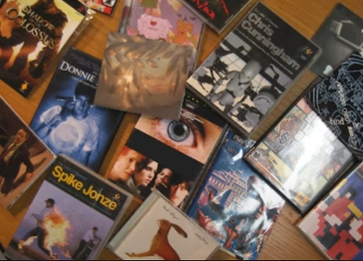
Features in an Image
Lines, edges, ridges, corners, blobs, etc
Which of these can be considered to be a good feature for a recognition task ?

Slide 6
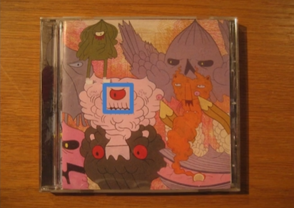
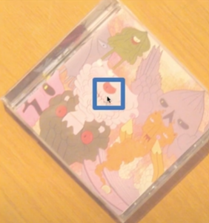
Challenges in matching images (recognition tasks)
Raw images are hard to match
Different size, orientation, lighting, brightness, etc

Slide 7
Solution to challenges in matching images (recognition tasks)
Removing sources of variation
Matching becomes easier when we remove variations like change in size and orientation
Find some interesting points/features in images that can be matched
Has rich image content (brightness variation, color variation, etc) within a local area
Has well defined representation/signature for matching with other images
Has well defined position in the image
Should be invariant to image rotation and scaling

Slide 8
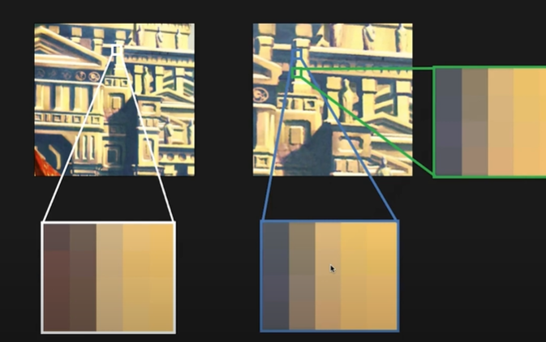
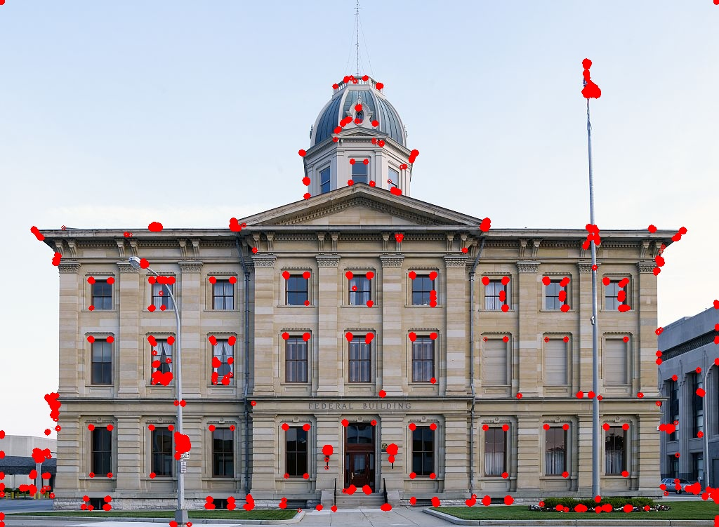
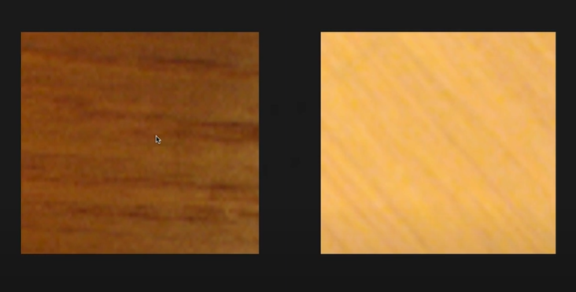
What are interesting points in an image ?
Are random image patches interesting ?
Are Lines interesting ?
Are Corners interesting ?
Are Edges interesting ?

Slide 9

What are interesting points in an image ?
Are blobs interesting ? Yes
Blobs are a group of pixel values that forms a somewhat colony or a large object that is distinguishable from its background
They are considered to be interesting points/salient features

Slide 10
Blobs as Interesting Points
For a blob like feature to be useful we need to do the following
Locate the blob
Determine its size
Determine its orientation
Formulate a descriptor/signature
We will achieve this using the SIFT Algorithm (Scale Invariant Feature Transformation)

Slide 11
SIFT (Scale Invariant Feature Transform)
It is a feature detection algorithm in Computer Vision
SIFT helps locate the local features in an image, commonly known as the ‘keypoints‘ of the image. These keypoints are scale & rotation invariant that can be used for various computer vision applications, like image matching, object detection, scene detection, etc.
The major advantage of SIFT features, over edge features or other features, is that they are not affected by the size or orientation of the image.

Slide 12

SIFT (Scale Invariant Feature Transform)

Slide 13
SIFT Algorithm
Construct a Scale Space – To make feature scale independent
Keypoint Localisation – Identifying the locations of suitable features/keypoints
Orientation Assignment – Ensuring that the keypoints are rotation invariant
Keypoint Descriptor – Creation of a unique descriptor/signature of detected keypoints

Slide 14
Construction of Scale Space
Identification of most distinct features that are not scale dependent and ignoring any noise present
Convert the image into grayscale and apply gaussian blur to remove noise
Since we need to ensure that the features must be scale independent we need to search for the features on multiple scales by creating a scale space
To create new sets of images of different scales we take the original image and keep on reducing its scale by half and create different blur versions of it

Slide 15
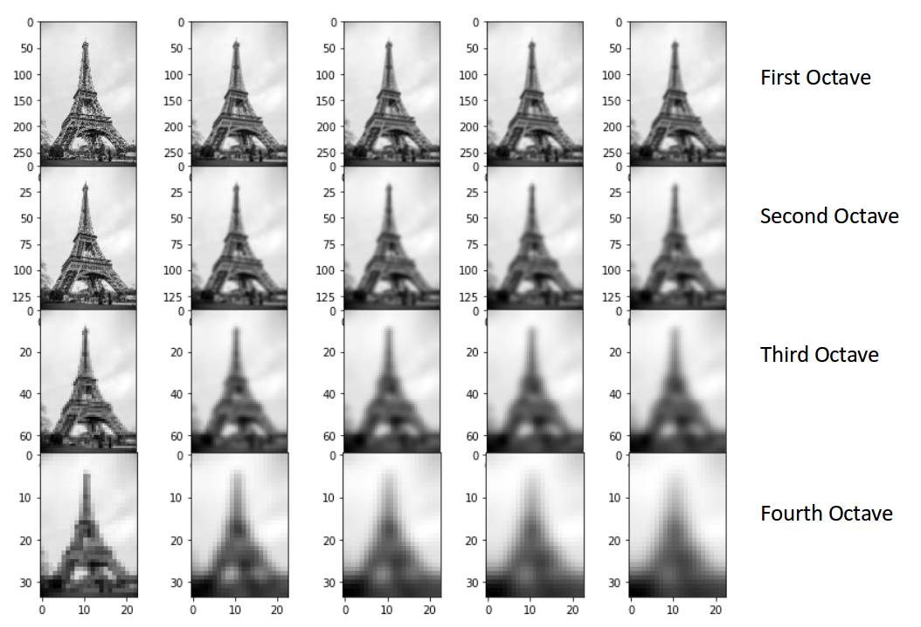
Construction of Scale Space
The ideal number of octaves should be four, and for each octave, the number of blur images should be five.

Slide 16
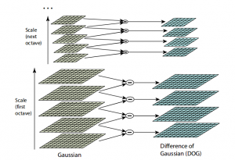
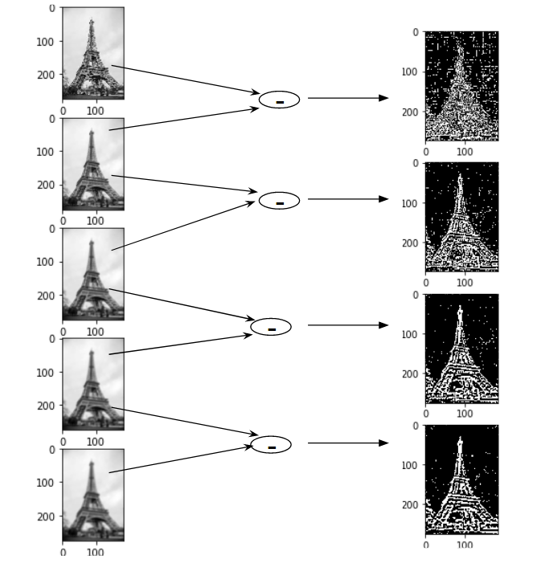
Construction of Scale Space
We have created images of multiple scales and used Gaussian blur for each of them to reduce the noise in the image. Now, we will try to enhance the features using a technique called Difference of Gaussians or DoG. DoG creates another set of images, for each octave, by subtracting every image from the previous image in the same scale.

Slide 17
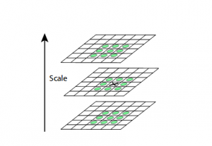
KeyPoint Localization: Local Maxima and Local Minima
Find the important key points from the image that can be used for feature matching by looking for maxima and minima in the result of DoG step.
To locate the local maxima and minima, we go through every pixel in the image and compare it with its neighboring pixels
Neighboring pixels not only includes the surrounding pixels of that image (in which the pixel lies), but also the nine pixels for the previous and next image in the octave. (compared with 26 other pixel values)
One more check is applied to select the most accurate key points

Slide 18
Keypoint Localization: Selection
We have now generate scale invariant keypoints, but some of these keypoints may not be robust to noise
We will eliminate the keypoints that have low contrast, or lie very close to the edge
To deal with low contrast keypoints
a second-order Taylor expansion is computed for each keypoint. If the resulting value is less than 0.03 (in magnitude), we reject the keypoint.
To deal with keypoints that are too close to the edge
A second-order Hessian matrix is used to identify such keypoints and they are removed
Now we have the most accurate keypoints which need to be assigned an orientation value so that they are rotation invariant

Slide 19
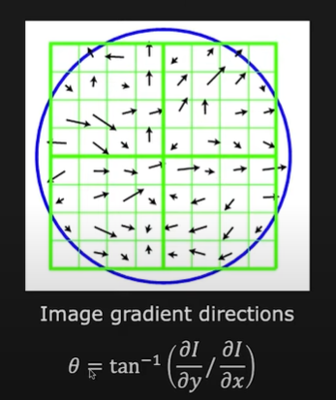
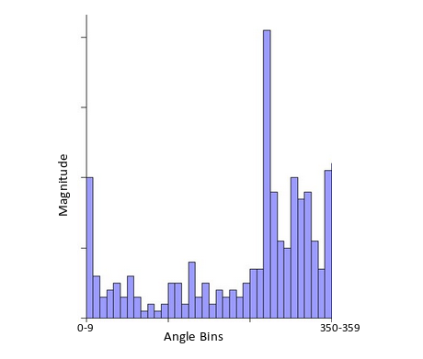
Orientation Assignment
Now that we have the stable and accurate keypoints we will assign orientation to them so that they are rotation invariant
Calculate the orientation – Calculate the orientation by using gradient operators for all the pixel points that fall within the keypoint blob
Calculate the histogram of orientation – Create a histogram by taking the angles of all the pixels inside the blob, the angle bin with the peak value becomes the principle orientation of the blob

Slide 20
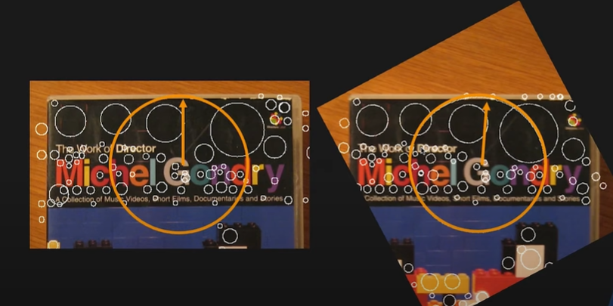
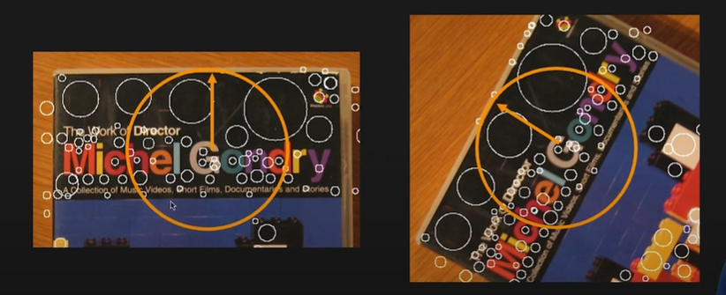
Why finding orientation is important ?

Slide 21
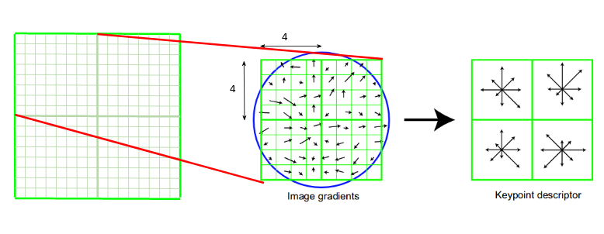
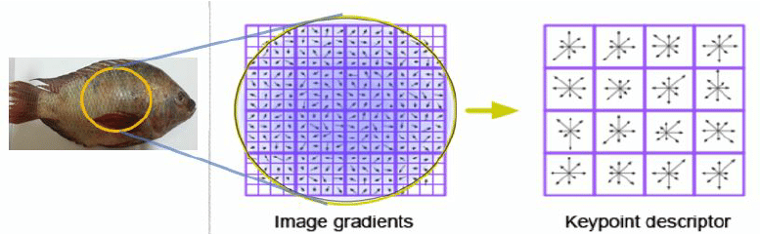
Keypoint Descriptor
Now that we have stable keypoints which are invariant to scale and rotation we just need to create a unique fingerprint for these keypoints called as descriptor which can be used for comparing the keypoints
We will first take a 16×16 neighborhood around the keypoint. It is divided into 16 sub-blocks of 4x4 size. For each sub-block, 8 bin orientation histogram is created. So a total of 128 bin values are available. It is represented as a vector to form keypoint descriptor.

Slide 22
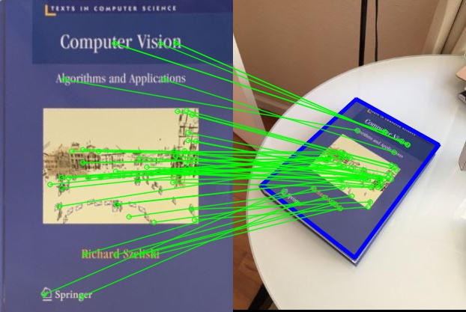
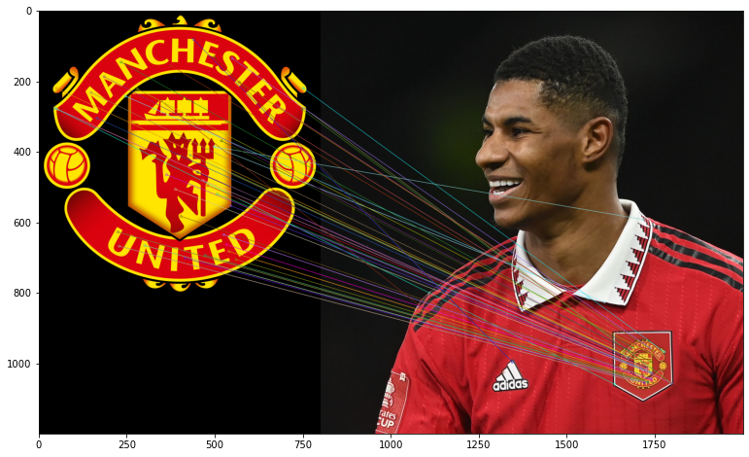
SIFT Output
Other similar and improved algorithms: SURF, ORB, BRIEF

Slide 23
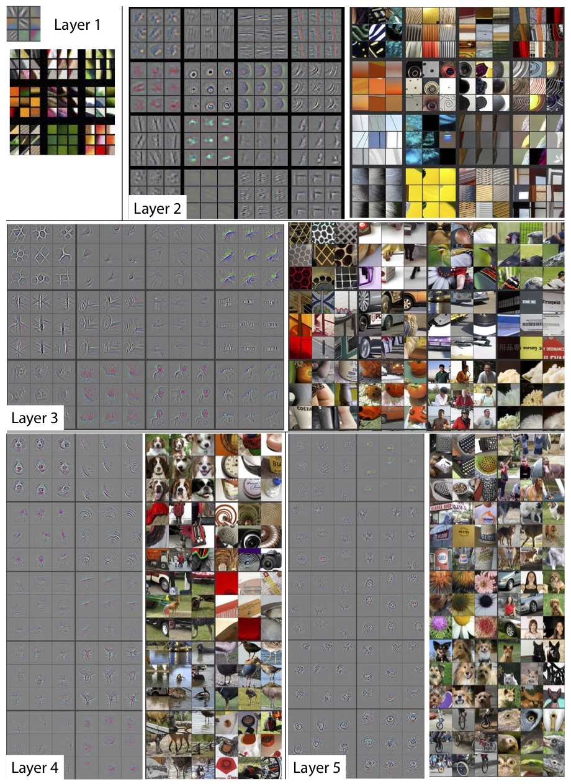
How CNNs learn ?
They are neural networks that look at the spatial patterns and learn basic features like edges, lines, corners etc in the earlier layers and advanced features like blobs forming objects in the later layers
The neural networks learn the patterns on their own during the training step itself
Note: Topic will be covered in details during the deep learning based computer vision section

Slide 24
Geometric Image Transformations

Slide 25
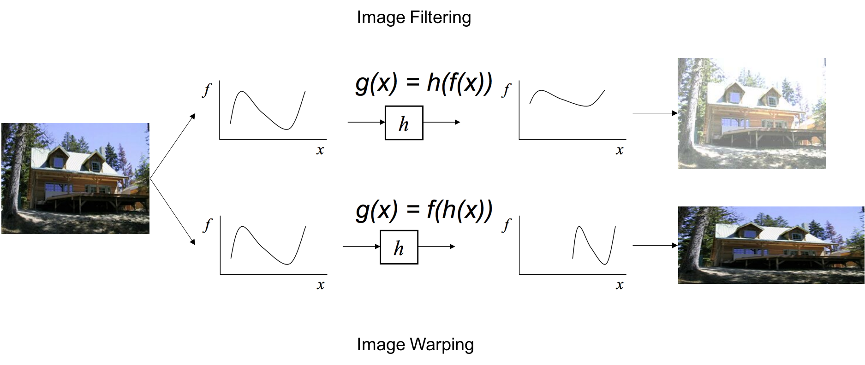
Geometric Image Transformations
Filtering: Change the pixel values in the image
Transformation: Change the position/spatial coordinates of the image

Slide 26
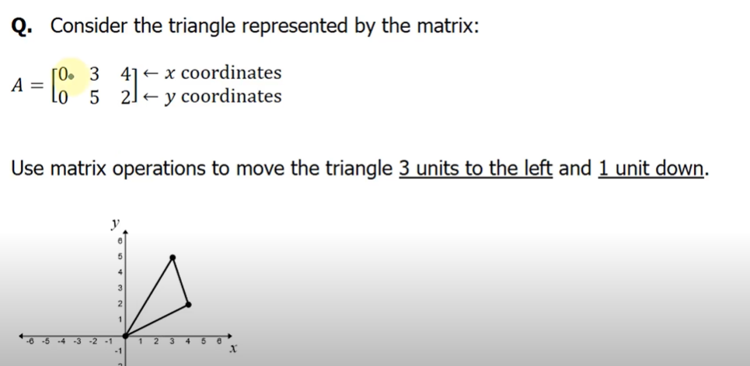
Example: How to perform a transformation on an image ?

Slide 27
Linear Transformations
Scaling
Rotation
Reflection
Shearing
Translation

Slide 28
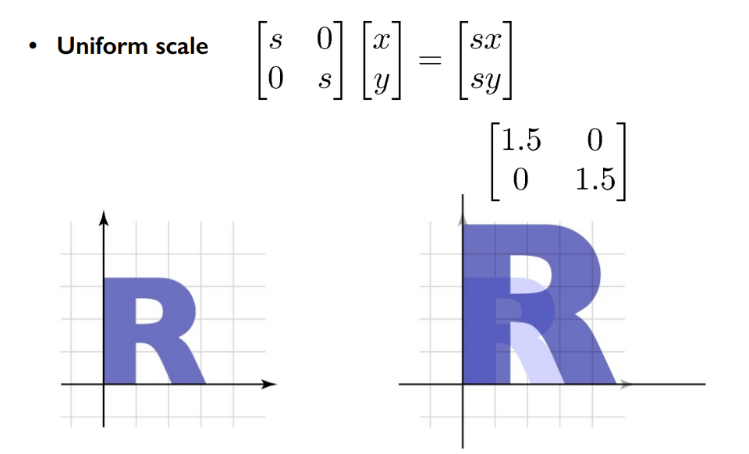
Scaling

Slide 29
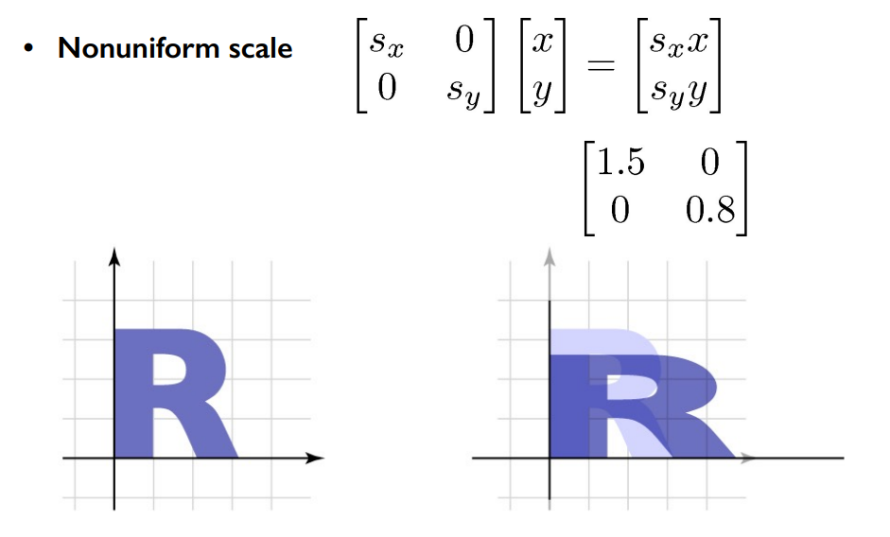
Scaling

Slide 30
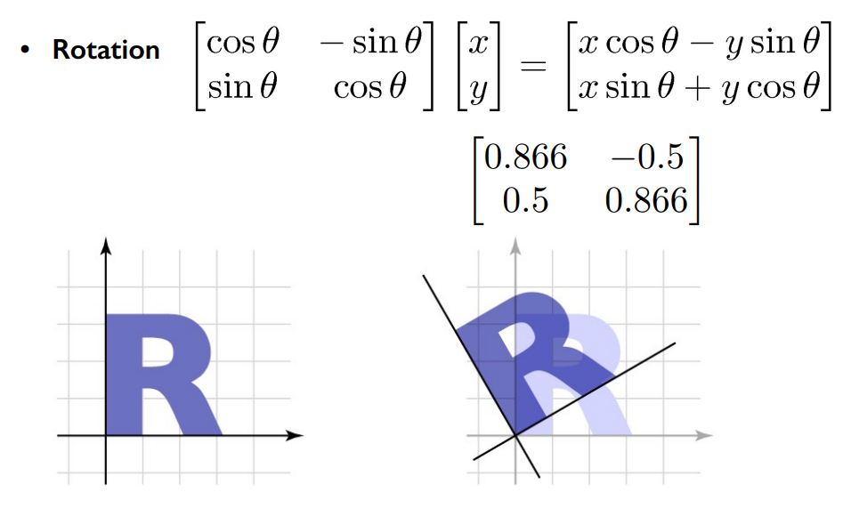
Rotation

Slide 31
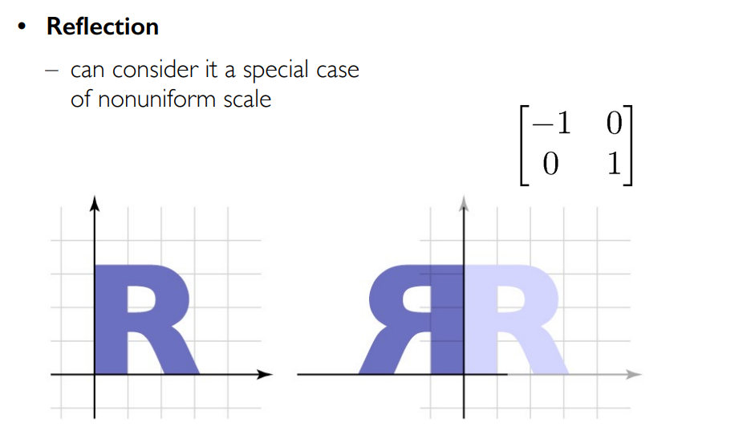
Reflection

Slide 32
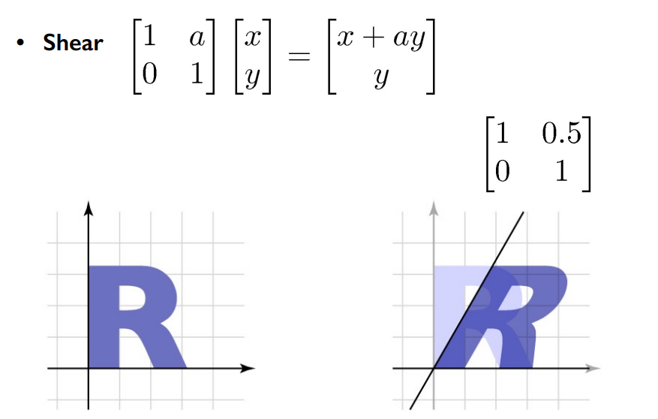
Shearing

Slide 33
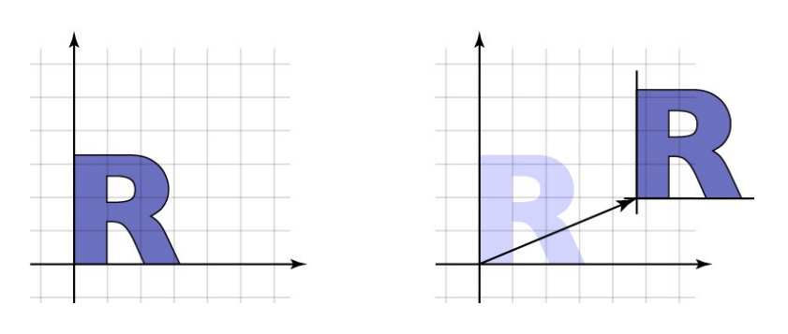

Translation
Can we represent the transformation matrix of translation using a 2x2 matrix ? Ans: NO
X
Y
1
X*1 + Y*0 + tx = translated X
X*0 + Y*1 + ty = translated Y
X*0 + Y*0 + 1 = 1

Slide 34
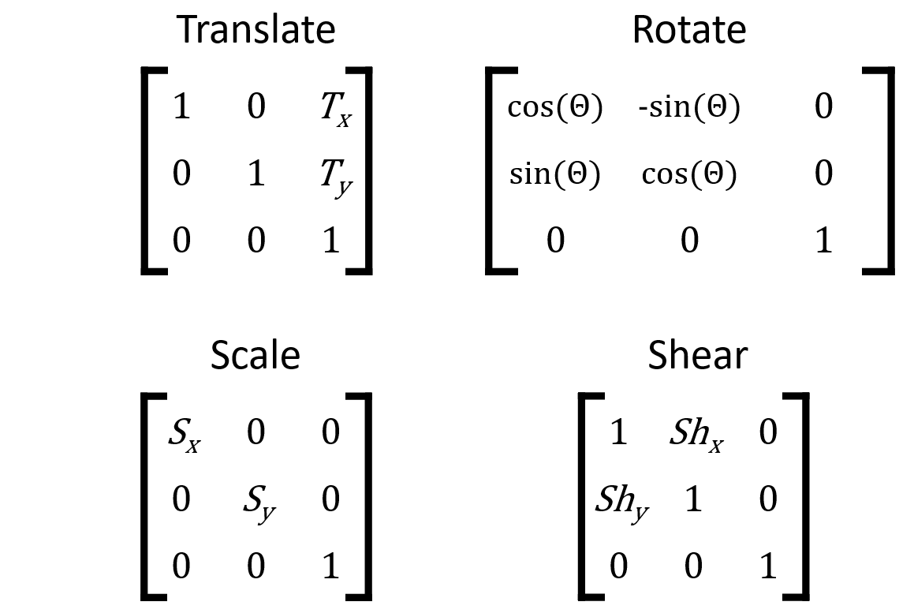
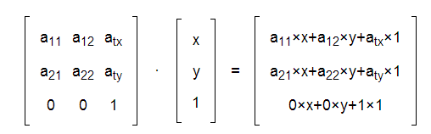
Collectively known as Affine Transformation
Combine all linear transformations into a single transformation matrix known as affine transformation matrix
It has 6 Degrees of Freedom (6 values where you can specify change/transformation)
I.e. you can perform translation+rotation+scaling using a single matrix
Lines map to lines, Parallel lines remain parallel
Origin may or may not always map to origin

Slide 35
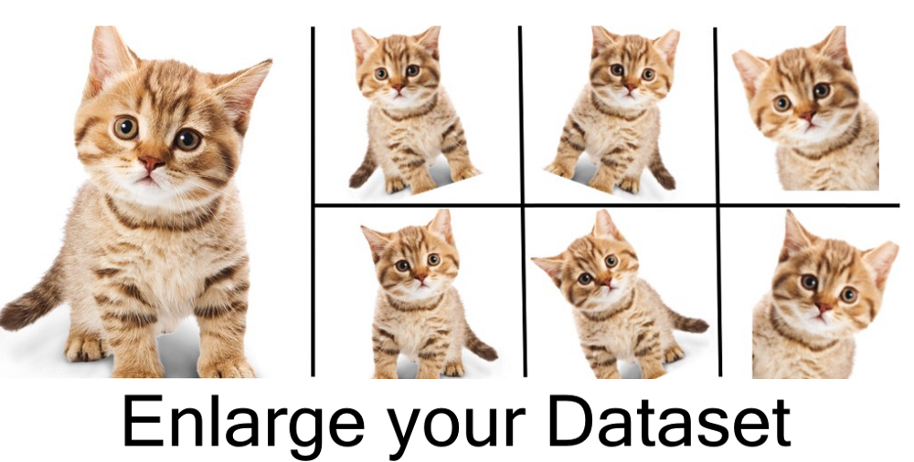
Affine Transformation Use Case

Slide 36
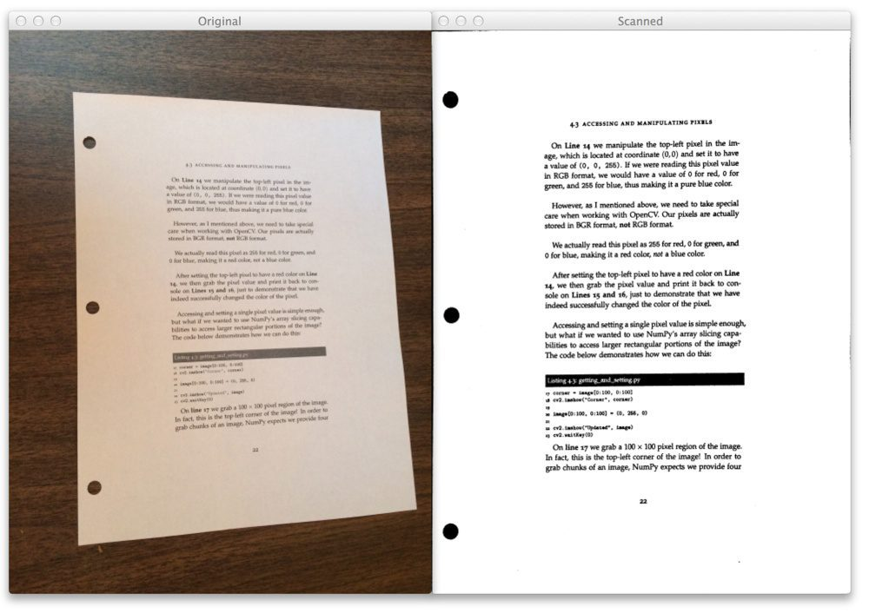
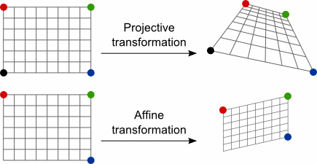
Projective Transformation
Mapping of one plane to another through points
E.g. Document scanners, tilted pictures of docs scanned and projected in an appropriate manner

Slide 37
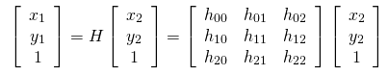
Projective Transformation
Mapping of one plane to another through points
E.g. Document scanners, tilted pictures of docs scanned and projected in an appropriate manner
3 x 3 Homography matrix is used to project one image from a plane onto another image plane
All the values in the homography matrix should sum up to 1, therefore there are only 8 degrees of freedom and not 9
Origin does not necessarily map to origin
Lines map to lines
Parallel lines do not necessarily remain parallel

Slide 38
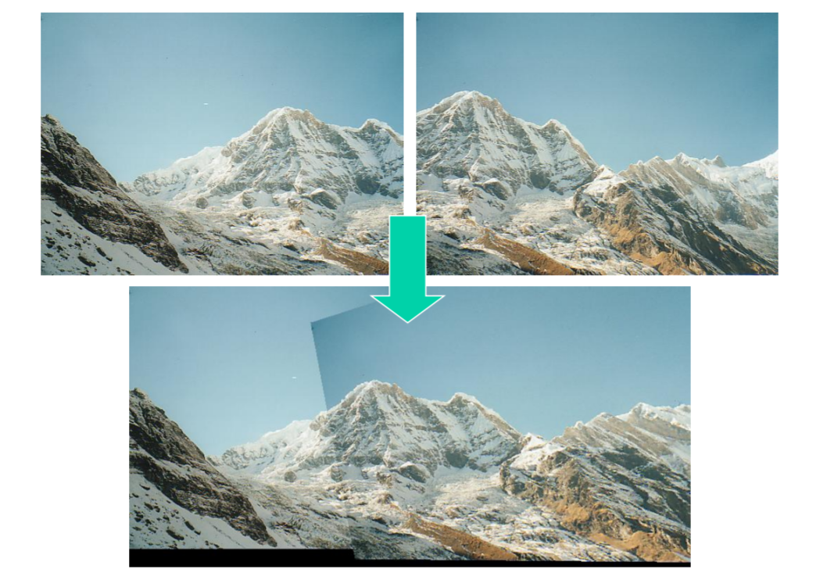
Image Stitching - Panorama
Detect Keypoints and extract local invariant descriptors from the two images – SIFT, ORB
Match the descriptors between two images
Use the RANSAC Algorithm to estimate a homography matrix using our matched feature vectors
Apply a warping/projective transformation using homography matrix

Slide 39
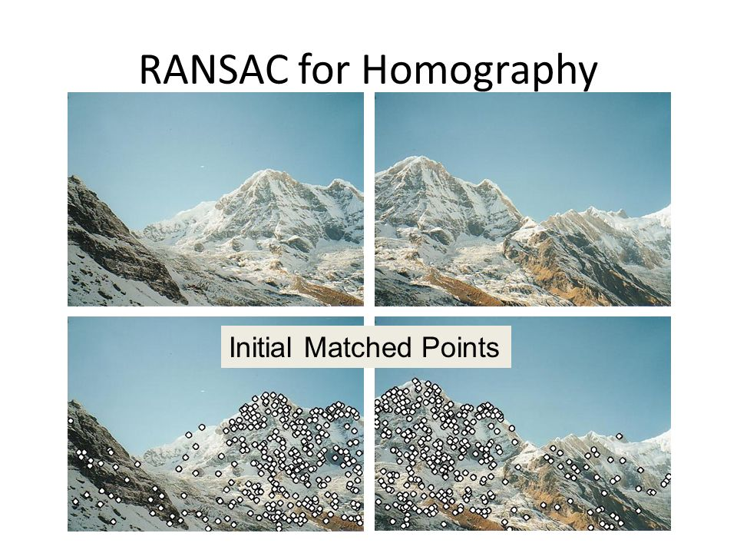
RAndom SAmple Consensus (optional)
Random choose s samples (typically 4). S is the min samples to fit a model
Fit the model to the randomly chosen samples
Count the number of data points/keypoints (inliers) that fit the model within a threshold error
Repeat steps 1 to 3 N times
Choose the model which has the larges number of inliers

Slide 40
Thank you
For any queries drop an email at: quadeershaikh15.8@gmail.com

